Slide 1
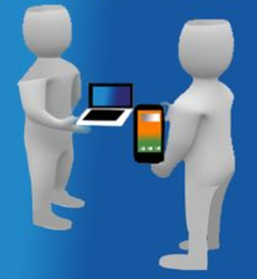
Exchange Used second-hand Goods with your neighbors
Presented by:
Li Pengfei
Li YueKang
Tang Yun

Slide 2
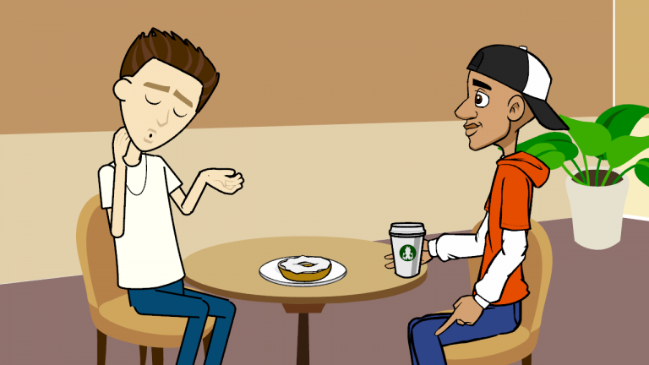
New Concept: Exchanger-Exchangee instead of Buyer-Seller
Can I exchange my drink for your hamburger?
Exchanger: the one who make an offer for exchange.
Exchangee: the one who is offered to exchange his/hers item.
Why not!
Exchangee
Exchanger

Slide 3
Exchange Article for Article instead of Article for Money
You don't feel like wasting money as you use your unwanted items to exchange for something you interested in.
Sensible resource allocation among the society and reduce waste effectively.
Connect neighborhood/community, promote social harmony.

Slide 4
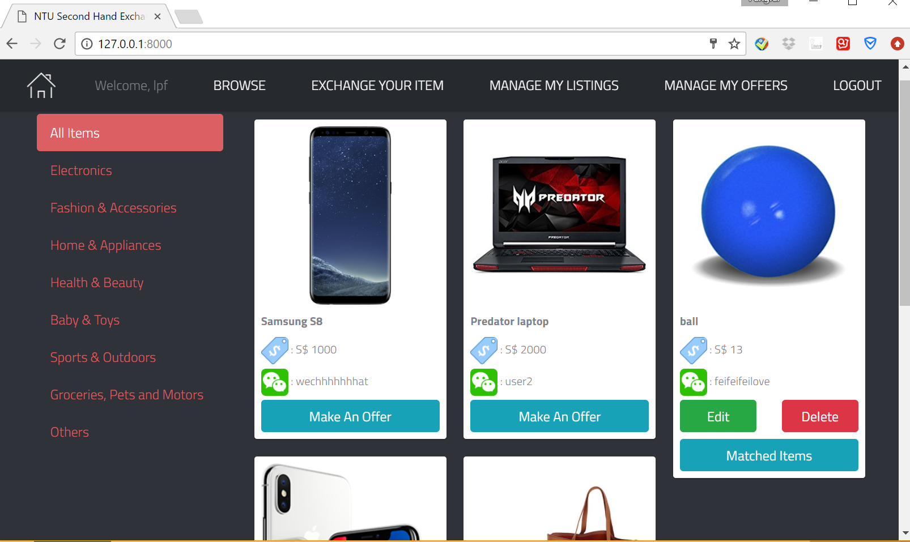
Second-Hand Goods Exchange Website

Slide 5
Second-Hand Goods Exchange Website - Navigation Panel
Browse
Personalized item recommendation.
What’s in Your Neighborhood
Location based (google map based on postal code).
Three categories: within your neighborhood, within your district, across the country.
Exchange Your Item
Provide item category, title, description, condition, estimated price, pictures, postal code.
After successfully listing the item for exchange, you can:
Get recommended items for exchange instantly and make an offer for exchange;
Wait other exchangers to give you an offer.

Slide 6
Second-Hand Goods Exchange Website - Navigation Panel
My Listings
Show all the items you have listed for exchange.
Can modify / update status (available / exchanged) /delete items.
My Offers
Item of interest & offer detail
Status: offer send to owner, accepted, declined.
My Profile
Personal info: username, email, change password, profile photo, phone number, Wechat number, address/postal code
Log out
Sign in / Sign up
Provide user authentication.

Slide 7
Exchange Process Flow
Cash offer (optional)
Exchanger
Browse website
Interested Items
Make an offer
Offer from own listings
Add a new item
Decline
Exchangee
Receive offer
Accept
Go for exchange ☺
Recommended items for exchange
Make an offer
Exchangee
Add a new item
Wait for offers from other exchangers

Slide 8
Machine Learning Solution
Hybrid Recommendation System:
Provide user-specific goods recommendation on ‘Browse’ page.
Collaborative-based filtering:
Create a vector based on user’s browse history, offers made, successful deal history, items listed for sell for each user.
Find the most similar users in the vector space using KNN model.
Perform element-wise XOR operation with these similar users and return the items.
Content-based filtering:
Create a user profile containing keywords of items based on browse history and offers made.
Construct tf-idf for user profile as well as each item.
Compute cosine similarity between user profile and the item, and return items with high similarities.

Slide 9
Machine Learning Solution
Automatic Item Matching System
Automatic item matching for exchange using machine learning based on big data.
Features of training data including item category, condition, market price (new), estimated price, market price difference, estimated price difference, whether same category, whether same condition, and location distance.
Training data created by crawling successfully dealt items on Carousell (a send-hand item selling platform). We label the items with closed deal price (5% variation) as match, others as not match.
Train a non-linear SVM classifier to predict whether two items can be matched.
Use the model to predict the match between the listed items, then return matched items to user’s specific listings.

Slide 10
Thank You !

